Slide 1
DATA STRUCTURE
Java Implementation

Slide 2
Array
Array is the collection of items, stored in a contiguous memory location.
The idea is to store multiple items of the same type together. This makes it easier to calculate the position of each element, by simply adding an offset to a base value, i.e. the memory location of the first element.
For example; if you have an array arr[5], the memory location of arr[0] is the base address.

Slide 3
Accessing ELEMENTS in an array
To access any other element in the array, the system adds an offset to the base address. The offset is calculated based on the index of the element and the size of each element
Example
int arr[5];
Recall integer takes 4 bytes in memory, if the base address is 1000, the memory addresses of the other elements can be calculated;
arr[0] at address 1000 (base)

Slide 4
Continuation…
arr[1] at address 1004(1000 + 1 * 4)
arr[2] at address 1008(1000 + 2 * 4)
arr[3] at address 1012(1000 + 3 * 4)
… and so, on
Note: The data at arr[i] is stored sequentially as it is indicated in the index, but the memory location don’t have to be sequential, we can have it stored as;
1000, 1012, 1008, etc.

Slide 5
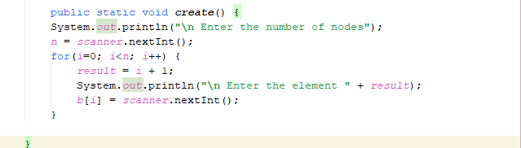
Create

Slide 6
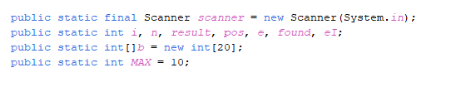
Continuation…
Recall:
If the array is dynamically allocated, an estimate of the maximum size of the list is required. usually this requires a high over-estimate, which wastes considerable space. this could be a serious limitation, especially if there are many lists of unknown sizes.

Slide 7
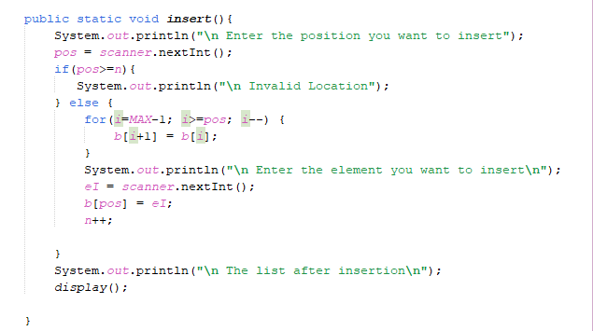
INSERT

Slide 8
Continuation…
Though the array can hold 20 elements, but the max represents the limit for operation within the program.
Now to insert into the list using the array implementation, all the element will be shifting one position to the right, i.e. after the position you want to insert.
Example:
arr[10, 30, 40, 50]
We want to insert an element 20 into the array at position 1 i.e. arr[1]
Though the max = 10;
for this operation we have a n = 4

Slide 9
For arr, the max is 4, so it goes 4-1 =3, is 3 greater than
Note: We are subtracting to get the position of the last element. the position(arr[1]) which is 1, if yes assign the value at b[3] to now be in b[4] i.e. b[i+1] = b[i] shifting it to the right, the array is now [10, 30, 40, 50, 50] after doing this i is reduced to 2 is 2 greater or equal to pos yes assign the value of b[2] to b[3] resulting in [10, 30, 40, 40, 50] after doing this i is reduced to 1 is 1 greater or equal to pos yes assign the value of b[1] to b[2] resulting in [10, 30, 30, 40, 50] from this, a new element can now be inputted at position one, making it
[10, 20, 30, 40, 50]

Slide 10
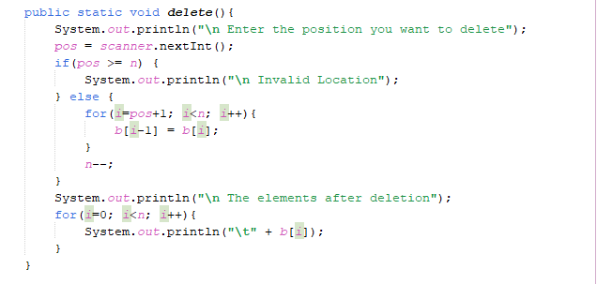
DELETE

Slide 11
Continuation…
same logic, but in this case, the elements re moved to the left

Slide 12
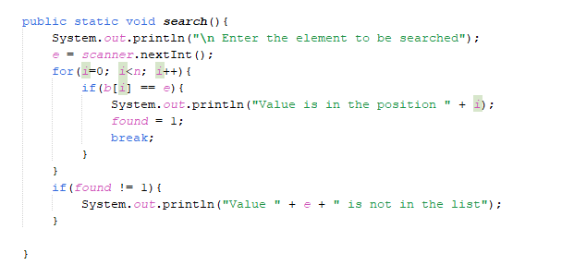
Search

Slide 13
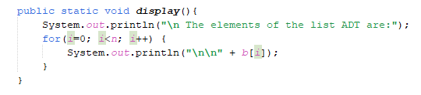
Display

Slide 14
Linked list
This is a dynamic structure, it usually used because array use a lot of resources just to insert and delete element, as all the elements has to be moved left or right depending.
It helps us to avoid contiguous storage of the elements in the list

Slide 15
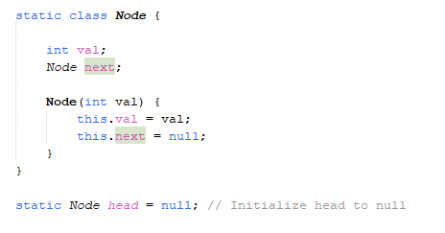
A linked list is a dynamic data structure, that has an element and a pointer, that points to the next node(which consist of a data compartment and a pointer called next)

Slide 16
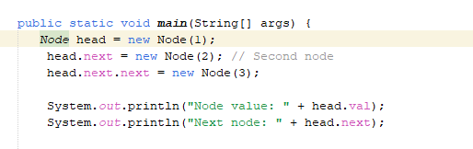
In contrast to array’s static method of specifying size before hand, for linked list, it is done dynamically.
Also, there is no need for malloc or calloc, in java as memory allocation and free of memory space is done dynamically by the JVM, just by using the “new” keyword, memory is allocated dynamically, as when needed.

Slide 17
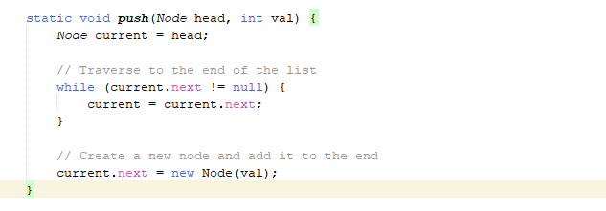
Push(adding an item to the end of the list)

Slide 18
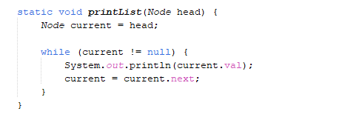
Iterating over a list

Slide 19
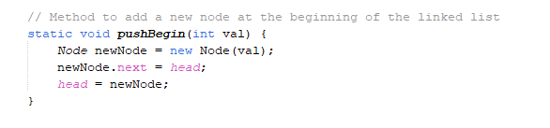
Adding item to the beginning of a list

Slide 20
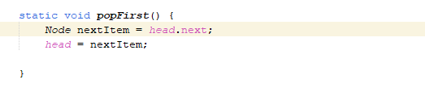
Removing first item

Slide 21
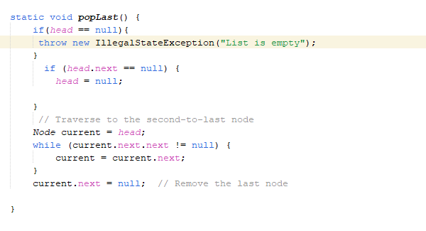
Removing last item

Slide 22
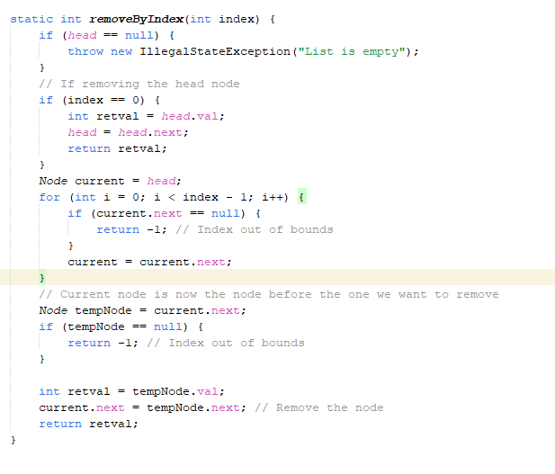
Removing a specific item

Slide 23
STACK
It is an ordered collection of items where the addition of new items and the removal of existing items always takes place at the same end. this end is commonly referred to as the “top.” the end opposite the top is known as the “base.” the base of the stack is significant since items stored in the stack that are closer to the base represent those that have been in the stack the longest. the most recently added item is the one that is in position to be removed first. this ordering principle is sometimes called lifo, last-in first-out. it provides an ordering based on length of time in the collection. newer items are near the top, while older items are near the base.
There are three basic operation; push(inserting), pop(removing), pip(display)
We have others such as peek, isDisplay, etc.
NOTE: We have both the static(Array) and the dynamic(Linked list) implementation of stack

Slide 24
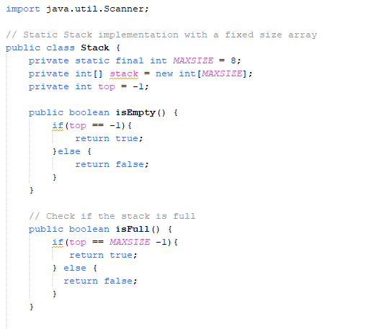
Array
From the code at the side, the max size of the array is defined, also top is set to be -1 showing that there is no element in the stack. isEmpty function is just to check if the stack is empty and it returns Boolean, either true or false. isFull function also a Boolean function checks if the top position is occupied based on the size the stack
The size of the stack is 8, meaning it can carry elements at the position 0, 1, 2, 3, 4, 5, 6, 7 that’s why you having MAXSIZE – 1, cause we dealing with position here so isFull function is checking if top = 7, if yes then it full, you can’t add any more.

Slide 25
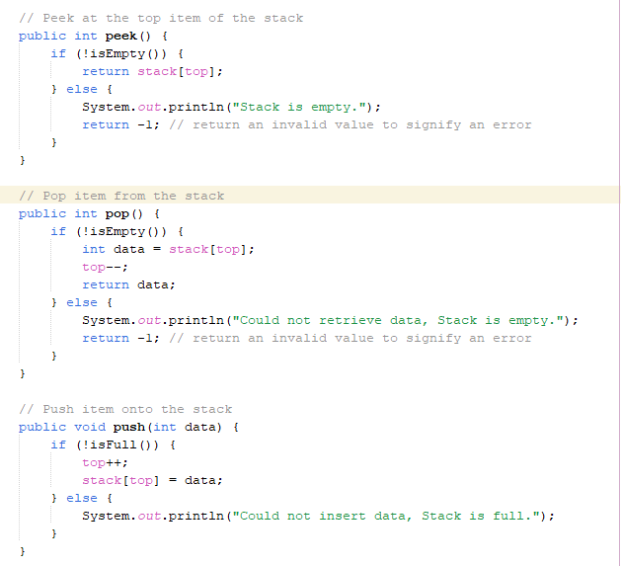
PEEK
Peek is an operation in the stack to return the most recent element, that is the element that is at the top of the stack, implying it was added last, from the code at the side, the peek function first check if the stack is empty, if its not empty it returns the element, else it prints “Empty stack” and returns -1 indicating error.
POP
Pop is an operation in the stack, it returns the item/element removed, it requires no parameter, all it does is removing the most recently added element from the stack, from the code at the side, the pop , if its not empty, it goes ahead, and delete the most recent element(the one at the top) it does this by reducing the top one place and the top becomes another element

Slide 26
For Example: private static final int MAXSIZE = 8; private int[] stack = new int[MAXSIZE]; private int top = -1; we have stack[10, 20, 30, 40, 50, 60, 70, 80] in the actual sense: 80
70
60
50
40
30
20
10
The last element added was 80, but in stack it’s on top and it will be removed first(LIFO). So, if we calling pop on this, we will have 80 returned.
And 80 is at position 7, meaning the top = 7 so, if pop is called it removes the most recent element by decrementing the top variable an assigning a new top to be 70 at position 6.

Slide 27
PUSH
We know that push is an operation in stack, that inserts an element to the stack, it accepts an argument, that is the item to be pushed and returns nothing.
It does this by first incrementing the top value and assigning the item to the new position stack[top] = data making it the element at the top.

Slide 28
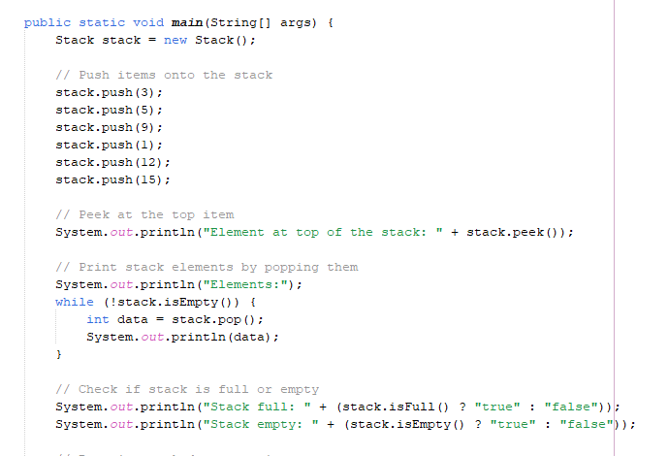
RESULT
Element at top of the stack: 15
Elements:
15
12
1
9
5
3
Stack full: false
Stack empty: true

Slide 29
LINKED LIST(Dynamic)

